Slide 1
Navigating ellipsis structures in memory:
New insights from computational modeling
Dan Parker
Linguistics Program
Computational & Experimental Linguistics Lab
College of William & Mary
dparker@wm.edu

Slide 2
Focus of this talk
Antecedent-ellipsis mismatches
What to make of syntactic mismatches between antecedent and ellipsis site?
This information could have been released by Gorbachov, but he chose not to ___ .
release this information
attributed to Daniel Shore, NPR, cited in Hardt 1993
How are mismatches represented mentally? How are they processed in real time?
Can experimental and computational evidence provide any insights?
Experimental investigations of mismatches
Mostly acceptability rating studies examining grammatical status of mismatches
Arregui, Clifton, Frazier, & Moulton, 2006; Kim, Kobele, Runner, & Hale, 2011

Slide 3
Antecedent-ellipsis mismatches
‘Acceptability cline’ across various forms of VP-ellipsis (VPE) mismatches
Passive-Active > Active-Passive
a. The student was praised by the old school-master, and the advisor did too.
b. The advisor praised the student, and the old school-master was too.
Verbal Gerunds > Nominal Gerunds
a. Singing the arias tomorrow night will be difficult, but Maria will.
b. Tomorrow night’s singing of the arias will be difficult, but Maria will.
Category N-VP > Adj-VP
a. The criticism of Roy was harsh, but Kate didn’t.
b. The report was critical, but Kate didn’t.

Slide 4
Existing accounts
Arregui et al. and Kim et al. make opposite claims about the grammatical status of VPE mismatches
Both agree cline reflects parser-specific heuristics that repair mismatches, improving acceptability
Today’s agenda
New account: based on recent insights from sentence processing theory, memory theory, and cognitive modeling
  No need to posit special parser-specific rules to capture cline
  Rather, cline reflects noisy memory retrieval mechanisms used to recover antecedent during comprehension
Proof-of-concept: Capture cline using a computational model of memory
Notable achievement: improved empirical coverage

Slide 5
Outline
Existing accounts of acceptability cline
New proposal
Experiment to confirm acceptability cline
Computational model
Results
Discussion

Slide 6
Existing accounts
Arregui et al., 2006
Kim et al., 2011
VPE requires syntactic identity
VPE mismatches are ungrammatical (strict relation between surface forms)
VPE requires syntactic identity
VPE mismatches are grammatical (flexible relation between surface forms)
Both agree
Ellipsis resolution relies on extra-grammatical parser rules that…
Restructure antecedent into a syntactically matching form (VP ‘recycling’ hypothesis)
(Over-)generate and rank a set of candidate antecedent representations
Cline reflects amount of repair work (more repair → lower acceptability)
Cline reflects amount of search work (more search → lower acceptability)

Slide 7
Example derivation from Kim et al., 2011: Voice (mis)matches
Voice mismatch imposes an acceptability penalty
Matching voice: Active-Active and Passive-Passive
AA: Jill betrayed Abby, and Matt did betray Abby too.
PP: Abby was betrayed by Jill, and Matt was betray by Jill too.
Mismatching voice: Passive-Active and Active-Passive
PA: Abby was betrayed by Jill, and Matt did betray Abby too.
AP: Jill betrayed Abby, and Matt was betrayed by Jill too.
Acceptability cline: {AA > PP} > {PA > AP}
Log Acceptability
(from modulus 0)
0.23
-0.30
-0.61
-0.70

Slide 8
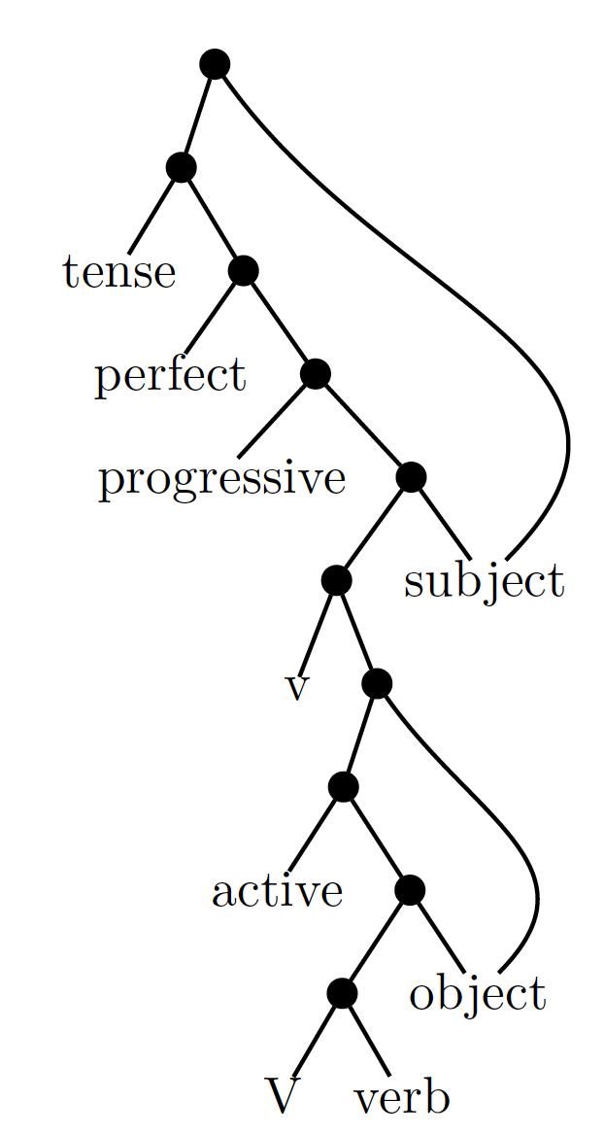
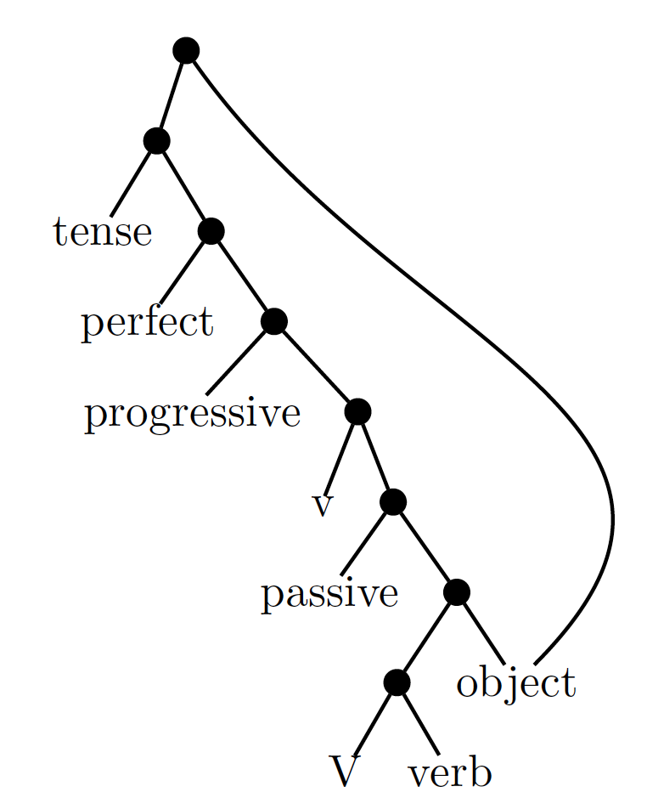
Example derivation from Kim et al., 2011: Voice (mis)matches
Cline reflects amount of search work
Ellipsis targets 3 possible positions:
Big V
Voice
Little V
Underlying structures
Parser considers all 3 options
Options ranked based on parsing heuristics
MaxElide: ellipsis preferentially targets higher nodes
little v > voice > big V
Subtrees consistent with heuristics explored first
Active antecedent
Passive antecedent

Slide 9
Example derivation from Kim et al., 2011: Voice (mis)matches
Matching voice (AA, PP): Ellipsis targets highest little v node, consistent with MaxElide
Mismatching voice (PA, AP): Ellipsis targets low big V node, violating MaxElide
More search work: Mismatches are less acceptable because parser must first search through higher ranked subtrees to find match
little v > voice > big V
Notice
Doesn’t explain AA > PP or PA > AP contrasts!
Active antecedent
Passive antecedent

Slide 10
Example derivation from Arregui et al., 2006: Gerunds
Cline reflects amount of repair work
Verbal Gerunds > Nominal Gerunds
VG: Singing arias tomorrow night will be difficult, but Maria will.
NG: Tomorrow night’s singing of the arias will be difficult, but Maria will
Critical observation: A VP exists in the antecedent for VG, but not for NG
Repair hypothesis: Restructure antecedent into a syntactically matching form
Restructuring VP antecedent from a VG is easier than manufacturing a VP antecedent from scratch using a NG
1-5 Likert
Rating
3.5
2.8

Slide 11
What do these accounts get us?
Careful judgment studies inform linguistic theory in 3 ways:
Representation: sensitivity to syntactic distinctions suggests that ellipsis requires a syntactic antecedent (e.g., rather than a semantic one)
Processing: Acceptability cline motivates special class of parser-specific rules
Architecture: Parser-specific rules reinforce grammar-parser distinction (i.e., separate structure-building systems for grammar and parser)

Slide 12
Outline
Existing accounts of acceptability cline
New proposal
Experiment to confirm acceptability cline
Computational model
Results
Discussion

Slide 13
Revisiting previous conclusions
Two reasons to revisit conclusions
Difficult to distinguish existing accounts of acceptability cline
  All appeal to parser-specific operations and make same predictions
Experimental findings for ellipsis resemble findings for other dependencies
  Ellipsis mismatches reflect ‘acceptable ungrammaticality’ (Arregui et al., 2016)
  Cases of ‘acceptable ungrammaticality’ found for range of dependencies
  But different conclusions are drawn about representations and processing architecture

Slide 14
Agreement Attraction
Ungrammatical subject-verb agreement treated as acceptable
*The key to the cabinets apparently were on the table.
Finding: Increased acceptability, reduced processing disruption for ungrammatical verbs due to number-matching distractor
Often described as a ‘grammatical illusion’
Similar effects observed for anaphora, Case licensing, and NPIs (Parker et al., 2014, Parker & Phillips, 2017, Bader et al., 2000, Slogget, 2013, Vasishth et al., 2008, Parker & Phillips, 2016)
(Pearlmutter et al., 1999; Wagers et al., 2009)

Slide 15
Leading account: Attraction reflects noisy memory retrieval mechanisms (Wagers et al., 2009)
Much evidence showing that syntactic dependencies are formed during comprehension using a parallel, cue-guided retrieval mechanism (McElree, 2000, McElree et al., 2003)
S
Subject
VP
The key
PP
to
the cabinets
were ...
Retrieval cues
1
0
0
0
0
1
+Subject
+Plural
Attraction reflects interference from ‘partial matches’
Creates the illusion that agreement is licensed

Slide 16
Memory retrieval account of agreement attraction
Attraction reflects grammar’s constraints implemented using noisy retrieval system
Crucially: acceptable ungrammaticalities are not taken as evidence for …
  special parser-specific rules
  distinct structure-building systems for grammar and parser
Rather, parsing relies on a single structure-building system (grammar), embedded in a general cognitive architecture
Question: Can acceptable ungrammaticalities involving ellipsis be explained in a similar fashion?

Slide 17
New account of ungrammatical but acceptable VPE
Ellipsis resolved in real-time by retrieving antecedent using parallel, cue-based retrieval (Martin & McElree, 2008, 2009, 2011)
Proposal: Acceptability cline is a product of noisy memory access mechanisms
What this account looks like
Grammatical constraints → cues: Identity constraints at the ellipsis site instruct retrieval mechanisms to find matching antecedent
Instructions are implemented as retrieval cues to find an antecedent with …
  specific features, e.g., matching category, voice, morphology, thematic structure, etc.
  … in a specific position, e.g., matching syntactic function, level of embedding, clause structure, etc.

Slide 18
New account of ungrammatical but acceptable VPE
Acceptability reflects overlap between retrieval cues and antecedent features
More overlap → faster retrieval and integration → improved acceptability
Assumption: processing time and acceptability monotonically related (Kim et al., 2011; Arregui et al., 2006; see also Dillon et al., 2015)
Proof-of-concept: Use computational modeling to make proposal explicit

Slide 19
Outline
Existing accounts of acceptability cline
New proposal
Experiment to confirm acceptability cline
Computational model
Results
Discussion

Slide 20
Experimental confirmation of acceptability cline
Problem: Previous studies used different designs, methodologies, and items
Solution: Controlled within-participants experiment using single measure

Slide 21
Experiment design
Items: Matching and mismatching voice, gerunds (common to all previous studies)
  Voice match: AA > PP
  AA: Jill betrayed Abby, and Matt did too.
  PP: Abby was betrayed by Jill, and Matt was too.
  Voice mismatch: PA > AP
  PA: Jill was betrayed by Abby, and Matt did too.
  AP: Abby betrayed Jill, and Matt was too.
  Gerund mismatch: verbal > nominal
  V: Singing the arias tomorrow night will be difficult, but Maria will.
  N: Tomorrow night’s singing of the arias will be difficult, but Maria will.
Method: Untimed acceptability judgments (7-point Likert scale)
Participants: N = 36 (requited via MTurk)

Slide 22
Results
Replicates previous studies
using a single measure
*
*
*

Slide 23
Outline
Existing accounts of acceptability cline
New proposal
Experiment to confirm acceptability
Computational model
Results
Discussion

Slide 24
Computational model of memory access
Simulate ellipsis resolution using the cue-based model of memory access
Developed by Lewis & Vasishth (2005) based on independently developed and empirically motivated properties of working memory
Successful model of retrieval for long-distance dependency formation, with good fit to wide range of behavioral data, e.g., agreement attraction

Slide 25
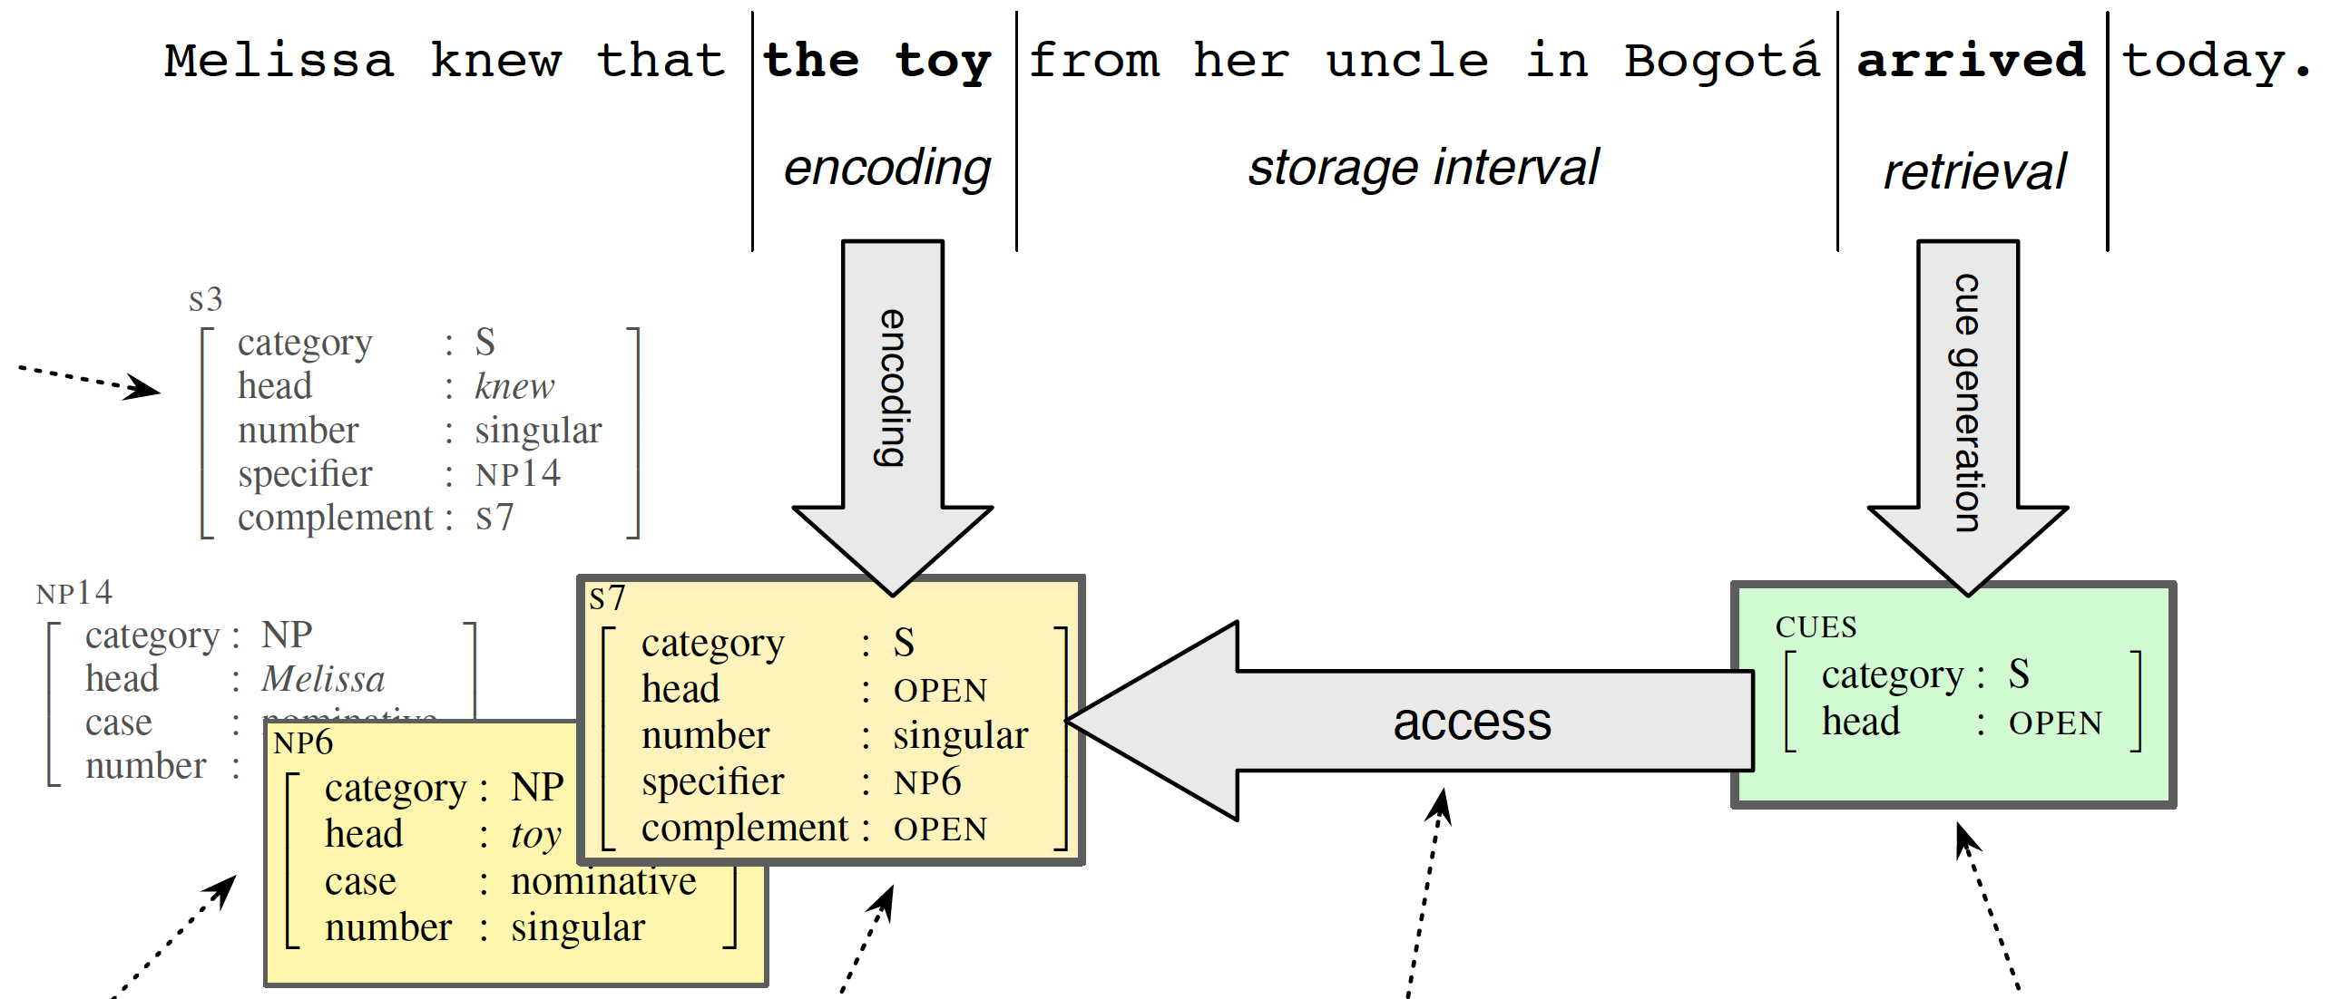
Key properties of model (based on findings from psychology of memory)
Parallel access All items in memory probed simultaneously
Content-addressable Items retrieved based on their content features
Susceptible to interference Items that partially match cues can be (mis)retrieved

Slide 26
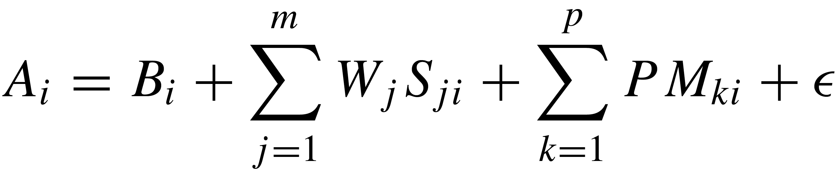
Retrieval model is ‘activation-based’
Items in memory activated based on 4 factors known to impact memory access
Activation is mathematically defined, providing the basis for the model
Item
activation
=
resting
activation
+
# of
competitors
+
degree of
match to retrieval cues
+
noise
Activation level determines model’s key dependent measure: retrieval latency (time to retrieve and integrate item)
  Better match to cues → higher activation → faster retrieval → more acceptable

Slide 27
Modeling VP-ellipsis
Cues used for antecedent retrieval
Model uses same properties described in previous work (Kim et al., 2011 and Martin & McElree, 2008, 2009, 2011)
Cue Value
Category VP, NP, etc.
Clause main, embedded
Voice active, passive
Marking -en (passive), NULL (active)
Values for each (mis)match determined by identity constraints at ellipsis site e.g., passive ellipsis site → passive cue values

Slide 28
Voice match
AA: Jill betrayed Abby, and Matt did too.
Retrieval cues Antecedent features
Category : VP Category : VP
Clause : main Clause : main
Voice : active Voice : active
Marking : NULL (active) Marking : NULL (active)
Voice mismatch
AP: Jill betrayed Abby, and Matt was too.
Retrieval cues Antecedent features
Category : VP Category : VP
Clause : main Clause : main
Voice : passive Voice : active
Marking : -en (passive) Marking : NULL (active)
Prediction: Lower acceptability for mismatches
poor match → lower activation → longer retrieval latency → lower acceptability
✔
✔
✔
✔
✔
✔
✘
✘

Slide 29
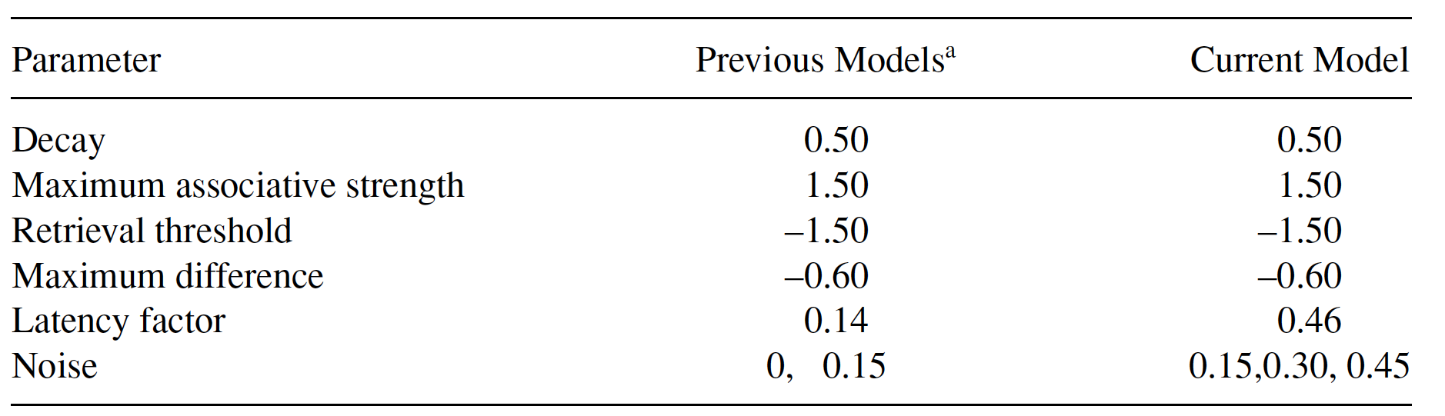
Computational model of memory access
Simulations
5000 Monte Carlo simulations run for each condition (AA, PP, AP, PA, gerunds)
All parameters set to default values (Lewis & Vasishth, 2005, Vasishth & Lewis, 2006, Vasishth et al., 2009)

Slide 30
Outline
Existing accounts of acceptability cline
New proposal
Experiment to confirm acceptability cline
Computational model
Results
Discussion

Slide 31
Voice match (AA > PP)
What drives the AA > PP contrast?
Additional routine retrievals for passives increase processing time, lowering acceptability
7
6
5
4
3
2
1
mean acceptability rating
Judgments
800
600
400
200
0
MODEL
predicted retrieval latency

Slide 32
7
6
5
4
3
2
1
Voice mismatch (PA >AP)
Both involve additional routine retrievals for passives
  PA > AP reflects more mismatching cues required by passive ellipsis site
7
6
5
4
3
2
1
mean acceptability rating
mean acceptability rating
Judgments
Passive cues Active antecedent
Category : VP ✔
Clause : main ✔
Voice : passive ✘
Marking : -en (passive) ✘
800
600
400
200
0
800
600
400
200
0
Active cues Passive antecedent
Category : VP ✔
Clause : main ✔
Voice : active ✘
Marking : NULL (active)
MODEL
predicted retrieval latency
predicted retrieval latency

Slide 33
Gerund mismatch (VG, NG)
VG: VP antecedent available, but in unexpected position
NG: No VP antecedent available, violating position and category expectations
7
6
5
4
3
2
1
7
6
5
4
3
2
1
mean acceptability rating
mean acceptability rating
Judgments
Retrieval cues VG antecedent
Category : VP ✔
Clause : main ✘
Voice : active ✔
Marking : NULL (active)
800
600
400
200
0
800
600
400
200
0
Retrieval cues NG antecedent
Category : VP ✘
Clause : main ✘
Voice : active ✘
Marking : NULL (active)
MODEL
predicted retrieval latency
predicted retrieval latency

Slide 34
Outline
Existing accounts of acceptability cline
New proposal
Experiment to confirm acceptability cline
Computational model
Results
Discussion

Slide 35
Computational model of memory access provides good fit to data
7
6
5
4
3
2
1
mean acceptability rating
800
600
400
200
0
predicted retrieval latency

Slide 36
Discussion
All accounts accurately predict certain aspects of the cline.
What distinguishes the retrieval-based account?
No recourse to special parsing rules or separate structure-building systems
Cline reflects single structure-building system (grammar) embedded in a general memory architecture
Improved empirical coverage: retrieval account captures 4 empirical facts that existing accounts fail to explain

Slide 37
Improved empirical coverage
Retrieval account captures AA > PP
  Recall: existing accounts predict no difference
  Retrieval account: contrast reflects additional retrievals for passives
800
600
400
200
0
predicted retrieval latency

Slide 38
Retrieval account captures PA > AP
  Existing account predict no difference
  Repair account: changing a passive antecedent into an active and vice versa should involve same number of repair steps
  Search account: both PA and AP delete at big V in violation of MaxElide, and involve same amount of search work
  Retrieval account: reflects more mismatching cues for passive ellipsis
800
600
400
200
0
predicted retrieval latency

Slide 39
Retrieval account captures voice matches > verbal gerunds
  Kim et al. (2011): “It remains mysterious under both accounts why verbal gerund are less acceptable than normal VPs”
  Retrieval account: verbal gerunds violate structural expectations
Retrieval account captures gerund mismatches > voice mismatches
  Voice mismatches involve more mismatching cues + additional retrievals for passives
800
600
400
200
0
predicted retrieval latency

Slide 40
Conclusion
Proposal: VPE acceptability cline reflects independently motivated properties of working memory
Computational model of memory provides good fit to data
Retrieval account offers explicit linking hypothesis connecting grammar and linguistic behavior
Next steps …
Sets the stage to test other mismatches examined in previous work
  ‘Comet’ mismatches : Seeing the comet was nearly impossible, but John did.
  Category mismatches: N-VP vs. Adj-VP
Current account explains behavioral responses (judgments, RTs), but … How are mismatches interpreted? What meaning is derived?

Slide 41
Thank you!

Slide 42
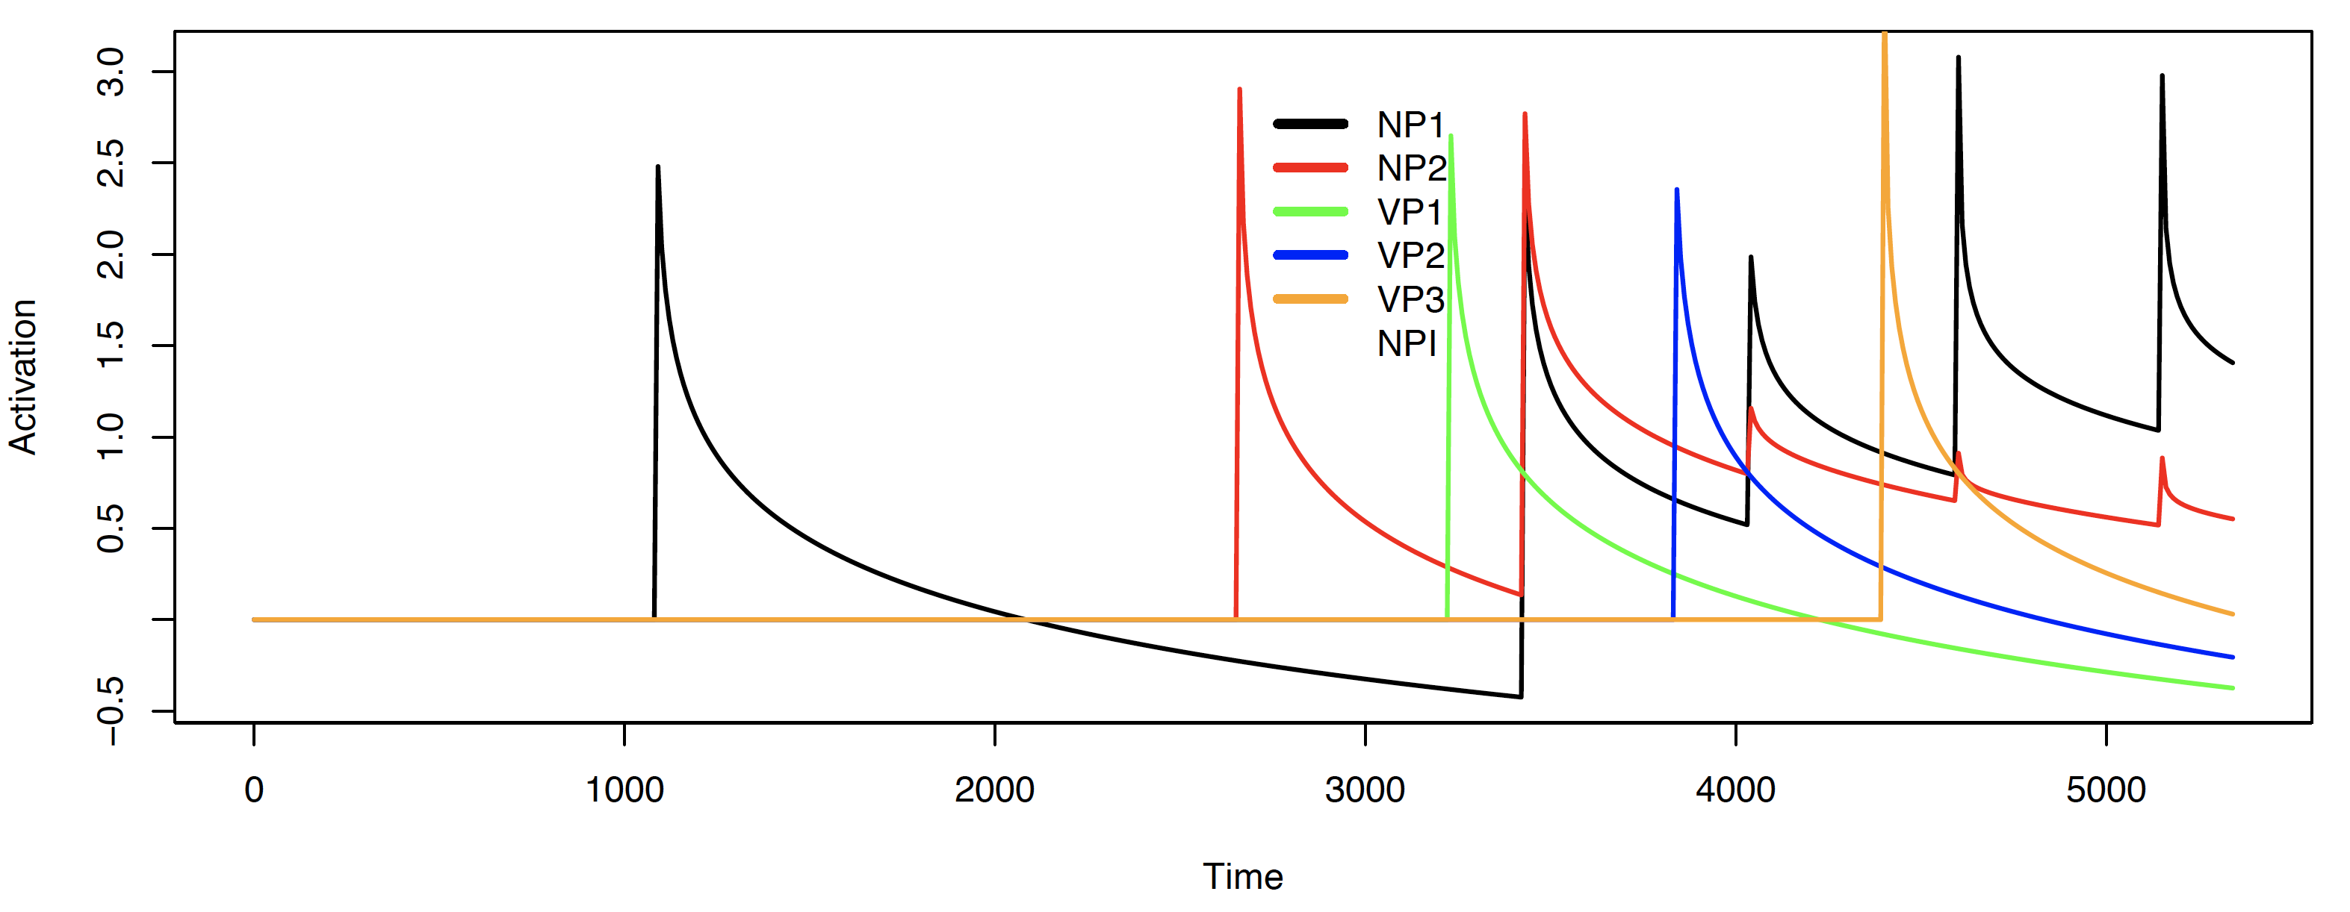
Activation over time
Activation level determines retrieval latency (time to retrieve and integrate item)
  Better match → higher activation → faster retrieval → improved acceptability

