Slide 1
Verbal mismatch and phonological identity in Peripheral ellipsis
Aoi Shiraïshi, Anne Abeillé
& Barbara Hemforth
LLF & IUF
University Paris Diderot
Labex EFL
Experimental and Corpus-based Approaches to Ellipsis
July 29 2017

Slide 2
PLAN
Syntactic mismatch in ellipsis
Peripheral ellipsis and mismatch
Corpus study
Acceptability judgment test
Eye tracking experiment
The status of RNR with mismatch
Analysis
Notes:
Based on previous work with françois mouret

Slide 3
1. Syntactic mismatch in Ellipsis
Ellipsis: Gapping, Right-Node Raising, Sluicing, VP ellipsis…
Syntactic mismatches occur when the elided material in the elliptical clause and the antecedent in the full clause have different syntactic material.

Slide 4
Syntactic mismatch in ellipsis
Tense mismatch in VP ellipsis
  (1) I have looked into this problem and you should (look into this problem)
Voice mismatch in VP ellipsis
  (2) This problem was to have been looked into, but obviously nobody did (look into this problem) (Hardt 1993, Kehler 2000, Kertz 2014…)
Verb form mismatch in Gapping
  (3) I want to try to begin to write a novel and Mary wants to try to begin to write a play. (Ross 1970)
Notes:
VP ellipsis and I did ≠ VP anaphora and I did it where no syntactic reconstruction is at stake

Slide 5
2. Peripheral ellipsis and mismatch
Usually called Right node raising (RNR)
  (4) John likes bananas but Mary dislikes bananas.
Can occur outside coordination:
  (5) The police said that’s fine, all the people said, that’s fine.
  (Bilbiie 2013 swbd-104656)
Can apply to non maximal constituents:
  (6) It was a sweet dog and an intelligent dog (SWB corpus)
Can apply to wordparts (Chaves 2008):
  (7) These events took place in pre-war Germany or in post-war Germany ?

Slide 6
Mismatch in Peripheral ellipsis ?
Stricter identity than other ellipsis is usually required (Beaver & Sag 2004, Chaves 2014…)
(8)*I like playing guitar and I will play guitar.
(9) *Paul saved himself, but Mary didn’t save herself.

Slide 7
Peripheral ellipsis and syncretism
Mismatch in factorable coordination like Right-Node Raising said to require syncretic forms (phonological identity) (Zaenen & Karttunen 1984, Pullum & Zwicky 1986…)
(10) a. *Either they or I are/am/is going to have to go.
b. Either they or you are going to have to go.
(11) a. I certainly will set the record straight
and you already have set the record straight
b.*I certainly will clarify the situation,
and you already have clarify/clarified the situation.

Slide 8
3.1 Corpus Study (English)
Many examples of verb mismatch on the web:
  Syncretic Verbal mismatch (past participle and infinitive)
  (12) I encourage anyone who has come across my presence or who will come across my presence to never limit yourself. (thecashlayproject.com/post/4690385610)
  Non syncretic Verbal mismatch (past participle and infinitive)
  (13) Her publicist Max Clifford said: "I think she's going to be remembered as a young girl who has saved an awful lot of lives, and who will, save an awful lot of lives.(news.bbc.co.uk/2/hi/entertainment/)

Slide 9
3.1 Corpus Study (English)
Corpus study (looking for coordinated relative clauses)
3 examples in the COCA (Corpus of Contemporary American English, 520 million words) (all non syncretic)
(14) The two teachers who have encouraged me the most and who continue to encourage me the most to follow my heart for photography
are Mr. Thomas Collins and Mr. Andrew Shapiro.
(PSA Youth Showcase, 2008)

Slide 10
Corpus study in English
(English Web 2013 19 billion words)

Slide 11
The examples cannot be VP ellipsis
Cataphoric VP ellipsis follows Langacker (1969)’s constraint on backward anaphora
Cataphoric VP ellipsis only occurs in a subordinate context as in (15a) and coordination such as (15b) should be analyzed as peripheral ellipsis.
(15) a. If you can, you should come tomorrow.
b. If you’re scared, you can, and you should, leave now.
(Frank Gallagher, John M Del Vecchio, The Bremer Detail, 2014)

Slide 12
3.2 Corpus study (French)
Verbal mismatch without syncretism exists on the web (Google search)
(16)… une carte interactive de tous les sites de production à grande échelle
... a map interactive of all the facilities of production at large scale
qui ont vu le jour, ou qui vont voir le jour
REL.SUBJ have seen the day, or REL.SUBJ will see the day
dans les mois qui viennent en France.
in the months REL.SUBJ come in France.
‘…an interactive map of large scale production facilities that have,
or that will see the day in the month to come in France.’
(France Inter, 2015/02/20)

Slide 13
Corpus Study (frTenTen, 10 billion words)
looking for coordinated relative clauses with tense aux
Syncretic Verbal mismatch (past participle and infinitive)
(17) Parler de sujets scientifiques, des innovations
Talking of subject scientific, a.pl innovations
qui ont impacté le quotidien du grand public
which have impacted the daily life of the large public
ou qui vont impacter le quotidien du grand public.
or which will impact the daily life of the large public.
‘Talking about scientific topics, innovations which have or which will impact the daily life of the public.’ (http://www.cnrs.fr/centre-est)
Notes:
Which syncretic forms are alowed are which are not is still an open question

Slide 14
Corpus Study in frTenTen 2012
Non syncretic Verbal mismatch (past participle and infinitive)
(18) Parmi les nominés, on retrouve les artistes
among the nominees, we find the artists
qui ont investi les scènes de France
who have invested the scenes of France
ou qui vont investir les scènes de France.
or who will invest the scenes of France.
‘Among the nominees, we find the artists who have
or who will invest the scenes of France.’
(www.etudiant-france.info)

Slide 15
Corpus Study in frTenTen 2012

Slide 16
The examples cannot be VP ellipsis
French does not have VP ellipsis: auxiliaries avoir (have), être (be) cannot appear without participle. (Abeillé & Godard 1996).
(19) a. *Jean a fini son travail, mais Marie n’ a pas.
Jean has finished his work, but Marie NEG has NEG.
‘Jean has finished his work but Marie has not.’
b. *Jean n’ est pas arrivé, mais Marie est.
Jean NEG is NEG arrived, but Marie is.
‘Jean did not arrive, but Marie did.’
Notes:
On going work with Crysmann

Slide 17
Difference between English and French
The percentage of syncretic forms is much lower in English than in French in the corpus study.
This may well be due to the lexical frequency of the relevant verbs.
90 % of French verbs belong to the 1st inflexion group (with -er infinitive and -é participle),
only about 20 English verbs have syncretic infinitives and participles (come, cost, cut, hit, put, set...).

Slide 18
4. Acceptability judgment test
Is verbal mismatch without syncretism acceptable in French peripheral ellipsis?
Online acceptability judgement test
  The experimental materials are inspired from corpus examples.
  24 items (12 items with syncretism, 12 items without syncretism)
  13 control items
  24 fillers
  37 French native speakers recruited on the Risc website (http://www.risc.cnrs.fr/) rated the sentences from 0 to 10.
  mean age = 32.7, SD = 15.07

Slide 19
Target items for syncretic verbal mismatch
fermé/fermer (close/closed)
(a) Peripheral ellipsis with mismatch with syncretism
Certaines agences immobilières ont déjà, ou vont bientôt fermer leurs portes.
‘Some estate agencies have already, or will soon close their doors.’
(b) coordination without ellipsis
Certaines agences immobilières ont déjà fermé leurs portes, ou vont bientôt les fermer.
‘Some estate agencies have already closed their doors, or will soon close them.’
(c) Peripheral ellipsis without mismatch
Certaines agences immobilières ont déjà, ou auront bientôt, fermé leurs portes.
‘Some estate agencies just have, or will-have soon closed their doors.’

Slide 20
Target items for non syncretic verbal mismatch
rejoindre/rejoint (join/joined)
(a) Peripheral ellipsis with mismatch without syncretism
Quelques électeurs vont bientôt, ou ont peut-être déjà rejoint le centre.
‘Some voters will soon, or may have already joined the center.’
(b) Coordination without ellipsis
Quelques électeurs vont bientôt rejoindre le centre, ou l'ont peut-être déjà rejoint.
‘Some voters will soon join the center, or may have already joined it.’
(c) Peripheral ellipsis without mismatch
Quelques électeurs auront bientôt, ou ont peut-être déjà rejoint le centre.
‘Some voters will soon have, or may have already joined the center.’
Notes:
Last example: scalarity

Slide 21
Control items
(a) grammatical
Certains commerçants ont déjà ouvert leurs magasins.
‘Some shopkeepers have already opened their stores.’
(b) ungrammatical (wrong verbal form)
Certains commerçants ont déjà ouvrir leurs magasins.
‘Some shopkeepers have already open their stores.’
(c) ungrammatical (wrong preposition)
Le syndic cherche de régler ce problème de fuite.
‘The trustee tries of address this problem of leakage.’
Notes:
No asymetric discourse relation

Slide 22
Results

Slide 23
Results
Items with peripheral ellipsis are judged slightly less acceptable than non elliptical items (ps < .09) but much more acceptable than ungrammatical controls (ps < .001).
We found no significant difference between ellipsis with and without mismatch for the syncretic verb and non syncretic verb.
There is no significant difference between syncretic (mean rate 7) mismatch and non syncretic (mean rate 6.9) mismatch.
The experiment suggests that syncretic forms do not have a special status in peripheral ellipsis in French
Notes:
Numerous examples

Slide 24
5. Eye tracking experiment
14.20923002
Is there any difference in processing between ellipsis with or without mismatch or between syncretic and non syncretic verb forms in French peripheral ellipsis?
The same materials as acceptability judgment test with minor adaptation
24 target items (12 items with syncretism, 12 items without syncretism
30 fillers
32 French native speakers participated. (mean age =34, SD=14.2)
We will focus on the critical region which corresponds to the right-node raised verb.

Slide 25
Target items for syncretic verbal mismatch
fermé/fermer (close/closed)
(a) Peripheral ellipsis with mismatch with syncretism
*Certaines agences immobilières ont déjà, *ou vont bientôt *fermer *leurs portes* à cause de la crise*.
‘Some estate agencies have already, or will soon close their doors because of the crisis.’
(b) without ellipsis
*Certaines agences immobilières ont déjà fermé. D'autres *vont bientôt *fermer *leurs portes *à cause de la crise*.
‘Some estate agencies have already closed their doors. Others will soon close them because of the crisis.’
(c) Peripheral ellipsis without mismatch
*Certaines agences immobilières peuvent déjà, *ou vont bientôt *fermer *leurs portes *à cause de la crise*.
‘Some estate agencies can already, or will-have soon closed their doors because of the crisis.’

Slide 26
Target items for non syncretic verbal mismatch
rejoindre/rejoint (join/joined)
(a) Peripheral ellipsis with mismatch without syncretism
*Ce sont des électeurs qui ont, *ou qui vont sans doute *rejoindre *le centre *avant le 31 décembre.*
‘These are some voters who have, or who can without a doubt join the center before 31 December.’
(b) without ellipsis
*Certains électeurs sont en train de changer d'avis. Ce sont ceux *qui vont sans doute *rejoindre *le centre *avant le 31 décembre.*
‘Some voters are changing their minds. These are the ones who will without a doubt join the center before 31 December.’
(c) Peripheral ellipsis without mismatch
*Ce sont des électeurs qui vont bientôt, *ou qui peuvent sans doute *rejoindre *le centre *avant le 31 décembre.*
‘These are some voters who will soon, or who can without a doubt join the center before 31 December.’
Notes:
Last example: scalarity

Slide 27
First pass reading time
First pass reading times: the duration of all fixations on the region
when encountered for the first time.
Ce sont des électeurs qui ont, ou qui vont sans doute rejoindre le centre.

Slide 28
First pass reading time
Non syncretic verb
Syncretic verb

Slide 29
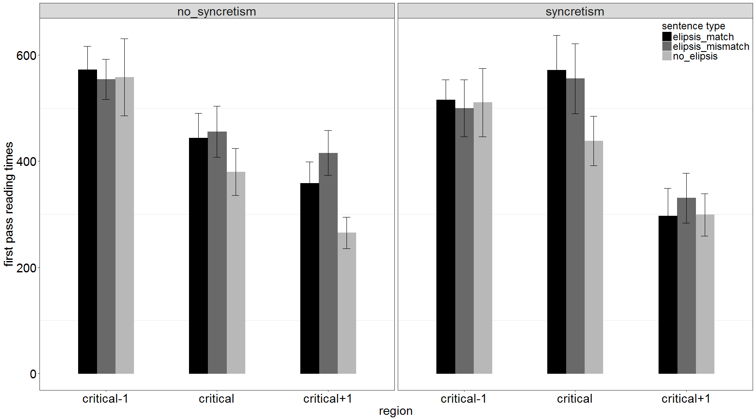
First pass reading times

Slide 30
First pass reading times
Shared verb (critical)
With linear mixed effects models,
we found no effect of syncretism and no effect of mismatch.
There is a significant difference between ellipsis and without ellipsis (mismatch vs. no ellipsis: t=-3.451, p<.001).
We found no effect of interaction of mismatch and syncretism.
Shared complement after the verb (critical+1)
There is a significant difference between mismatch and match and between mismatch (t=1.652, p<.09) and without ellipsis (t=-3.595. p<.001)
The difference between mismatch and match only occurs for non-syncretic forms (marginal interaction: t=-1.717, p<.09).
The difference between mismatch and without ellipsis only occurs for non-syncretic forms (interaction: t=3.562, p<.001)

Slide 31
Regression path duration („go past“)
Regression path durations: the summed fixation duration from when the
current interest area is first fixated until the eyes enter an interest area to the right.
Ce sont des électeurs qui ont, ou qui vont sans doute rejoindre le centre.

Slide 32
Regression path duration
Non syncretic verb
Syncretic verb

Slide 33
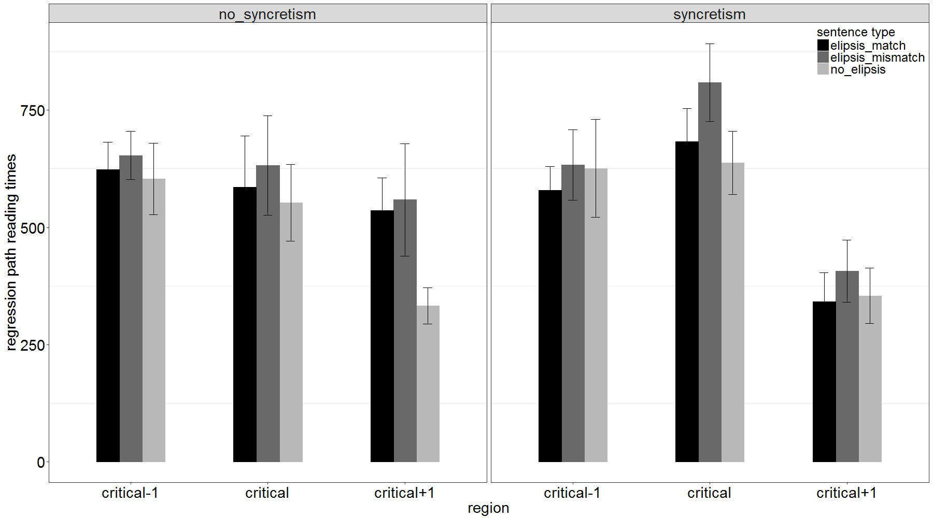
Regression path duration

Slide 34
Regression path duration
Shared verb (critical)
With linear mixed effects model,
we found no effect of syncretism and no difference between match and mismatch (ps > .15).
There is a significant difference between mismatch and without ellipsis (t=-3.216, p<.002).
We found no effect of interaction of mismatch and syncretism.
Shared complement after the verb (critical +1)
There is no significant difference between mismatch and match but a significant difference between mismatch and without ellipsis (t=-3.53, p<.001).
The difference between mismatch and without ellipsis only occurs for non-syncretic forms (interaction: t=2.279, p<.05).

Slide 35
Total reading time
Total reading times: the duration across all fixations on the current interest area.
Ce sont des électeurs qui ont, ou qui vont sans doute rejoindre le centre.

Slide 36
Total reading time
Non syncretic verb
Syncretic verb

Slide 37
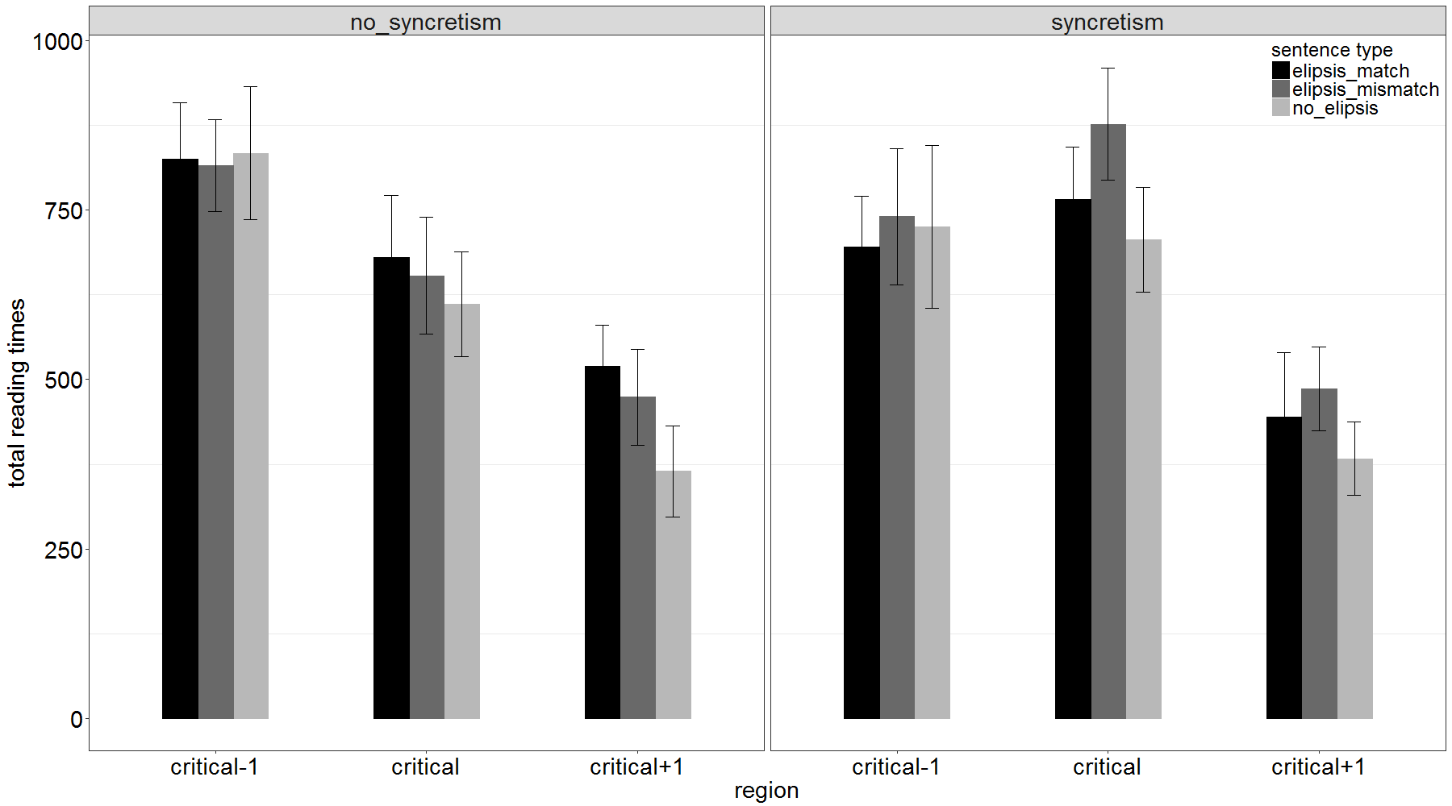
Total reading time

Slide 38
Total reading time
Shared verb (critical)
With linear mixed effects model,
we found no effect of syncretism and no effect of mismatch.
There is a significant difference between mismatch and without ellipsis (b) (t=-3.060, p<.003).
We found no effect of interaction of mismatch and syncretism.
Shared complement after the verb (critical +1)
We found a significant difference between mismatch and without ellipsis (b) (t=-4.02, p<.001)
There is no significant difference between mismatch and match.
We found no interactions.

Slide 39
Results
We found systematically higher reading times for mismatch than without ellipsis for syncretic verb and for non syncretic verb.
Although we found no effect of syncretism in the critical region, the reading time of non syncretic mismatch is longer than that of without ellipsis in the area after the critical region. This may indicate a difference between syncretic forms and non syncretic forms.
Peripheral ellipsis with mismatch does not seem to be systematically more difficult as could be expected if it were ungrammatical.

Slide 40
The status of peripheral ellipsis with mismatch
Ungrammatical but repaired ?
Grammatical

Slide 41
Ungrammatical but repaired?
Arregui et al. (2006) VP recycling hypothesis claims that when a syntactically matching antecedent is not available, the listener/reader creates one using the materials at hand.
we found no evidence of systematic processing load increase in the mismatch cases.
Repair either does not work in the processing of non-syncretic as well as the syncretic forms or it is so fast and efficient that it does not lead to systematic processing difficulty.

Slide 42
Grammatical
Pullum & Zwicky (1986): only syncretic forms are grammatical (“phonological resolution of syntactic feature conflict”).
The acceptability judgment test shows no difference between mismatch and match and between syncretic and non syncretic verbs.
The eye tracking experiment do not show systematic difficulty for mismatches for non-syncretic or for syncretic verbs.
We conclude that the most economic hypothesis is that peripheral ellipsis with mismatch with or without syncretism is part of the grammar.

Slide 43
Summary
Corpus studies have found numerous examples of peripheral ellipsis with verb mismatch in English and French.
Acceptability judgment test and eye tracking experiment show that :
peripheral ellipsis with verbal mismatch is as acceptable as without mismatch.
syncretic forms do not have a special status in peripheral ellipsis.
Peripheral ellipsis with verbal mismatch with or without syncretism should be integrated in the grammar

Slide 44
6 Analysis
6.1 Previous approaches
Raising: across-the-board rightward movement
(Ross 1967, Steedman 1996, Sabbagh 2007)
[John likes _ but Mary dislikes _] bananas.
Multidominance (McCawley 1982, Moltmann 1992, Bachrach & Katzir 2008)
[John likes but Mary dislikes] bananas.
Phonological deletion (Kayne 1994, Hartmann 2000, Chaves 2014)
[John likes bananas] [but Mary dislikes bananas].

Slide 45
Previous analyses of peripheral ellipsis
Syntactic mismatch casts doubt on:
-Raising analysis
-Multidominance analysis
-Deletion under syntactic identity
calls for a revised deletion analysis
Abeillé, Crysmann, Shiraïshi CSSP 2015
Shiraïshi& Abeillé Headlex 2016
Notes:
Thanks to barbara and dario

Slide 46
Lexemic Identity
Verbal mismatch shows that lexeme identity plays an important role. The past participle and the infinitive share the same lexeme.
Homonyms cannot be shared
(20) # Robin swung and Leslie tamed an unusual bat.
(Levine & Hukari 2006)
(21) # On a des avions qui ont et des accusés qui n’ont pas volé.
‘We have planes that have and defendants that have not flown/stolen.’

Slide 47
Tense feature must be the same?
The tense feature is meaningful and not syntactically imposed;
Phonological identity is not sufficient : no sharing between simple present and past and between past participle and simple future
(22) *At present the project managers, but in the past the executive directors, set the research priorities (Pullum & Zwicky1986).
French: Aller+Vinf ≠ simple future
(23) a. *certaines agences ont déjà fermé leurs portes
ou fermeront leurs portes
b. * les artistes qui ont investi les scènes de France
ou qui investiront les scènes de France.
c. * les électeurs qui ont rejoint le centre
ou qui rejoindront le centre
.

Slide 48
Closest Conjunct Agreement and peripheral ellipsis
In case of conflict, the requirement of the second conjunct wins.
Closest conjunct agreement may interfere with peripheral ellipsis.
Lexical coordination of verbs:
(24) …the strength of the city’s tourism industry and the recent rise in visitors has and will continue to play a major role.
(USA Today, 2010/04/27)
Lexical coordination of nouns:
(25) …pour rediriger le ou les travaux vers leur nouvelle destination.
‘…to redirect the-sg or the-pl jobs to their new destination.’
(Gilles Lemaitre, Backup exec pour Windows server: sauvegarde et restau,2007)

Slide 49
Conclusions
Peripheral ellipsis (RNR) is often considered to impose stricter identity conditions than other ellipsis (syncretic forms)
Corpus study confirms the existence of verbal mismatch in peripheral ellipsis (RNR) in English and French.
Acceptability judgment test and eye tracking experiment show that there is no systematic difference between match and mismatch and between syncretic and non syncretic verb in French peripheral ellipsis and that phonological syncretism does not have a special status.
Peripheral ellipsis with verbal mismatch with or without syncretism may thus integrated into the grammar.
Lexeme identity plays an important role.
In case of conflict, the requirement of the second conjunct wins.
Notes:
Identity condition should be relaxed

